Slide 1
Capstone Guide:
Profile & Cover Photos for
LinkedIn and WhatsApp

Slide 2
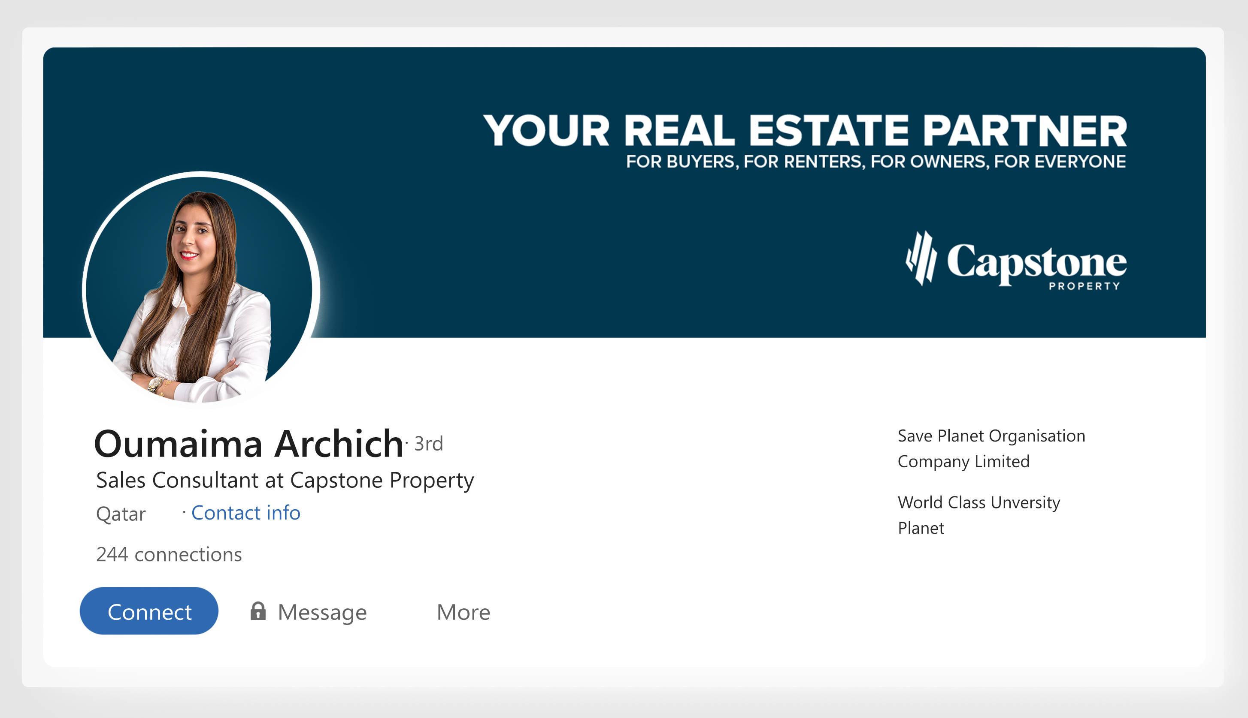
LinkedIn Preview

Slide 3
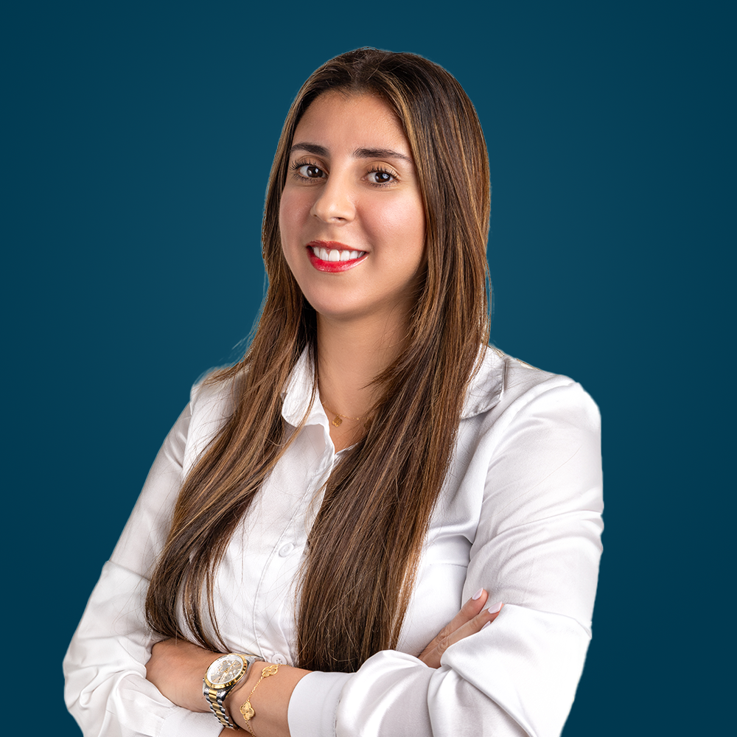

LinkedIn Profile Picture
Recommended Size: 400 x 400 pixels (1:1 ratio)
LinkedIn Cover Photo
Recommended Size: 1584 x 396 pixels
Linkedin Source File: Approved

Slide 4
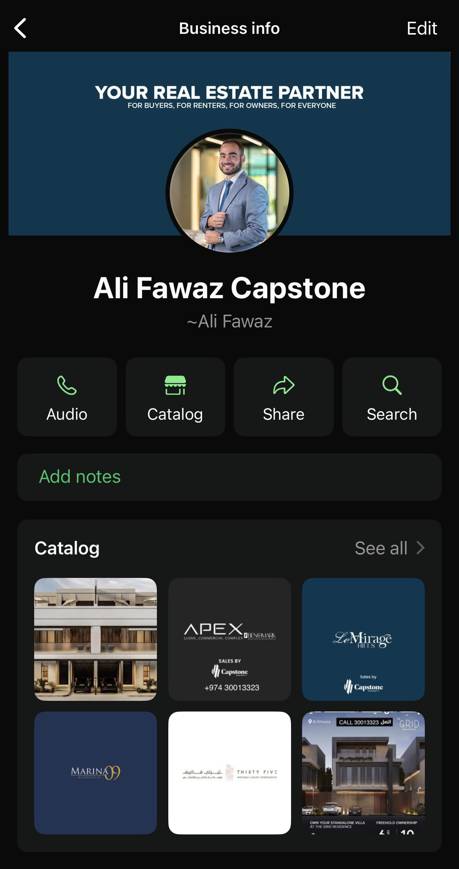
WhatsApp
Profile Preview

Slide 5
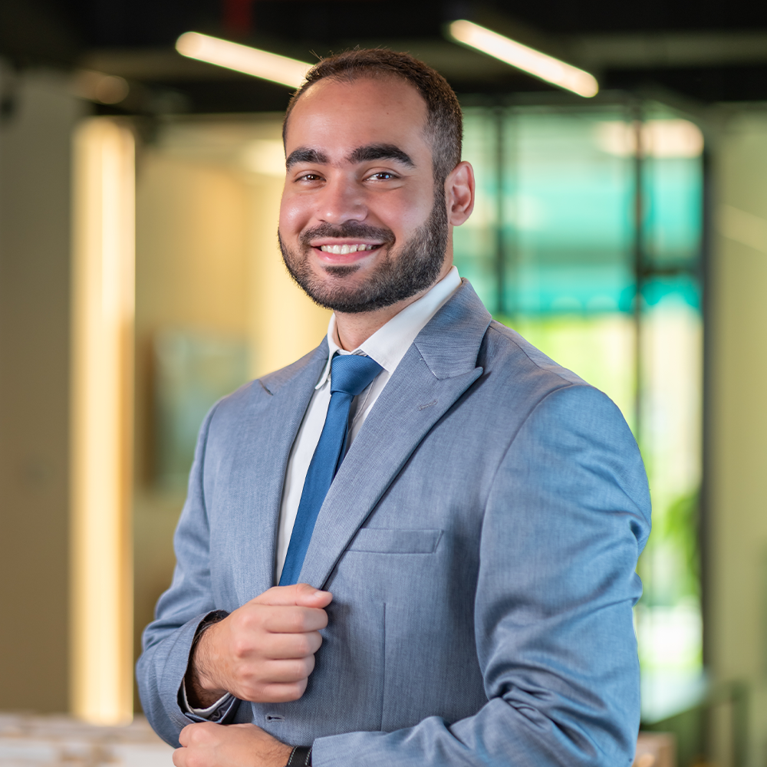

WhatsApp Profile Picture
Recommended Size: 640 x 640 pixels (1:1 ratio)
WhatsApp Cover Photo
Recommended Size: 1211 x 681 pixels
WahtsApp Cover Source File: WhatsApp

